Slide 1
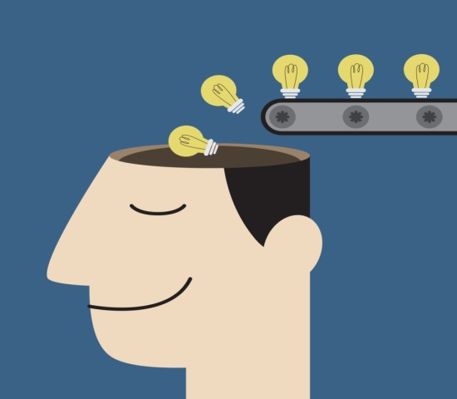
IDEATION
IDEATION TECHNIQUES

Slide 2
Ideation as a System.mp4

Slide 3

PROBLEM STATEMENT
DEFINE THE

Slide 4

WISHING
USE I WISH STATEMENTS TO SPUR IDEAS

Slide 5

SUPERHERO
HOW WILL THE SUPER HERO SOLVE THIS PROBLEM?

Slide 6

WRITE FAST
WRITE FAST QUICKLY AND WITHOUT STOPPING

Slide 7
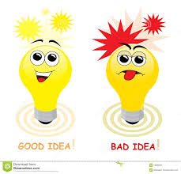
WORST IDEA EXCURSION
START WITH WORST IDEAS AND THEN Think OF THE OPPOSITE

Slide 8
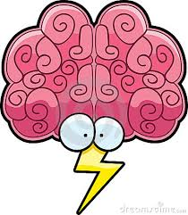
BRAINSTORMING
USE THE IDEATION TECHNIQUES

Slide 9
BRAINSTORMING
Harnessing the collaborative power
Notes:
The term was popularized by Alex Faickney Osborn in the 1953 book Applied Imagination.

Slide 10
CONCEPT OF BRAINSTORMING
Silent
verbal

Slide 11
Guidelines to brainstorming

Slide 12
Approach with wonder
Do not judge
Try yes instead of but
Remember that quantity leads to quality
Encourage edgy ideas..the weirder the better
Be playful….the more fun it is the more creative you will be.

Slide 13

DESIGNING SOLUTIONS

Slide 14

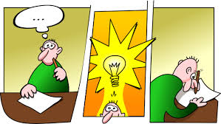
FEEDBACK NEW IDEAS

Slide 15

REFLECTION

Slide 16

A wonderful guy named Timothy Prestero has a company called
... Design That Matters.
They decided to tackle this really pressing problem of, high infant mortality rates in the developing world.

Slide 17
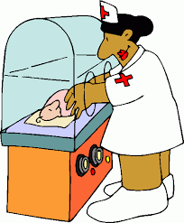
if we can keep premature babies warm, basically -- it's very simple -- we can halve infant mortality rates in those environments. So, the technology is there. These are standard in all the industrialized worlds

Slide 18


The problem is,
if you buy a $40,000 incubator,
and you send it off to a mid-sized village in Africa,

Slide 19
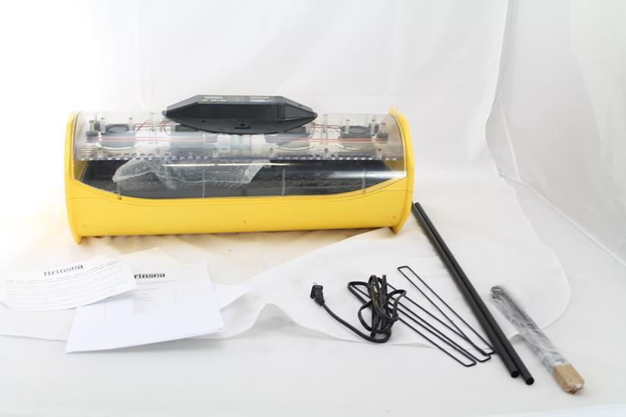
it will work great for a year or two years, and then something will go wrong and it will break………………

Slide 20
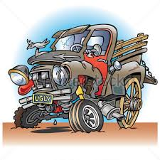
and it will remain broken forever,
because you don't have spare parts,
and you don't have the on-the-ground expertise to fix this

Slide 21

So what Prestero and his team decided to do is to look around and see: what are the abundant resources in these developing world contexts?

Slide 22
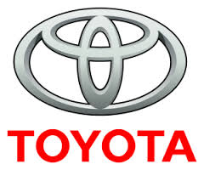
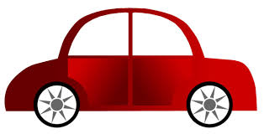
And what they noticed was they don't have a lot of washing machines….
they don't have a lot of microwaves…..
But
Their streets are filled with TOYOTA cars

Slide 23
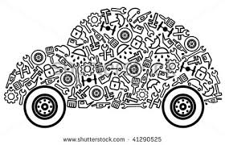
So they started to think, "Could we build a neonatal incubator that's built entirely out of automobile parts?“

Slide 25
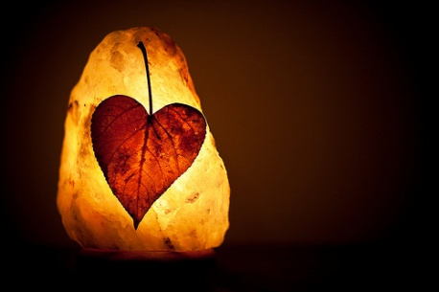
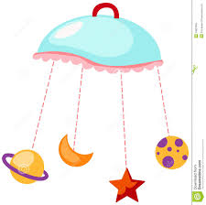
From the outside, it looks like a normal little thing you'd find in a modern, Western hospital.
In the inside, it's all car parts.
It's got a fan,
it's got headlights for warmth,
it's got door chimes for alarm --
it runs off a car battery.

